Slide 1
Performance Comparison Between LQR, PD, MPC for Inverted Pendulum with Actuator Dynamics & Constraints
Seung Yun (Leo) Song
Mechanical Science and Engineering
University of Illinois, Urbana-Champaign
Urbana IL, USA
ssong47@illinois.edu
Notes:
Hello. My name is Leo Song, and I will be talking about performance comparison of three controllers for inverted pendulum system with actuator dynamics and constraints

Slide 2

Study Goals
To design and analyze three controllers* (i.e., LQR, PD, MPC) on a virtual inverted pendulum on cart system with realistic actuator dynamics & constraints
LQR, PD – two classical controllers for linear time-invariant model
MPC – a modern controller for nonlinear time-variant model
Notes:
The study goal is to design and analyze three controllers on a virtual inverted pendulum on cart system with realistic actuator dynamics & constraints
To understand the performances of all types of controllers, we chose three different controllers: two classical controllers (LQR, PD) for linear time invariant systems (LTI) and one modern controller (MPC) for nonlinear time variant system.

Slide 3
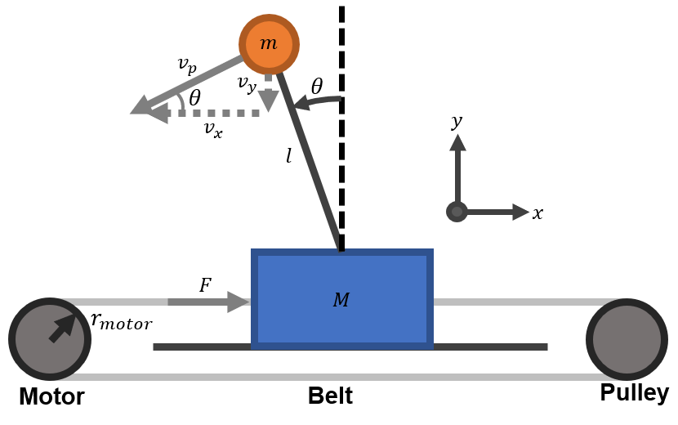
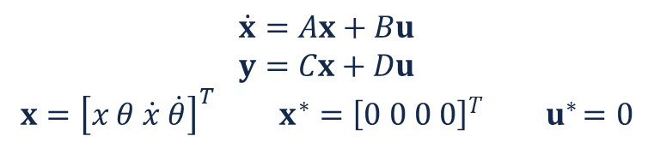
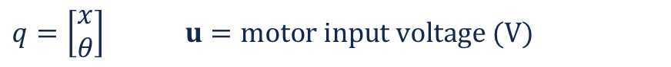
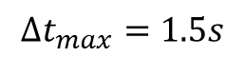
System Model
Nonlinear Model
$$\ddot{q}={(D}^{−1}\left(q\right)+J_{rotor}) \left(B_{e}u−C\left(q, \dot{q}\right)−G\left(q\right)−B_{damp}\dot{q}\right)$$
$q=\left[\begin{aligned}x \\ θ\end{aligned}\right]$ $u=motor input voltage (V)$
Fig. 1. Inverted pendulum system for this study
(see Appendix for system parameters)
Linear Model
$$\dot{x}=Ax+Bu$$
$$y=Cx+Du$$
$$x={\left[x θ \dot{x} \dot{θ}\right]}^{T} x^{∗}={\left[0 0 0 0\right]}^{T} { u}^{∗}=0$$
$$∆t_{max}=1.5s$$
36
Abs.Max
12
Soft Max
0
Time
Actuator Dynamics & Constraints
Motor Voltage (V)
-12
Soft Min
Commercial brushed DC motor with planetary gearbox (5202-0002-0027, goBilda Winfield, KS USA)
-36
Abs.Min
Fig. 2. Motor voltage saturation algorithm
Notes:
The cart pole system was moved by a motor-belt-pulley system (Fig. 1). Inertia of the pole and frictional force was neglected.
The nonlinear model was obtained through Euler-Lagrangian Formulation that includes the actuator dynamics and constraints.
A state space linear model was obtained by linearizing the nonlinear model about the equilibrium point using taylor expansion.
Actuation input had absolute limit of $±$36V with soft limit of $±$12V maximum of 1.5 seconds since a short burst of overvoltage is allowed in real systems. We used an existing commercial brushed DC for this study.

Slide 4
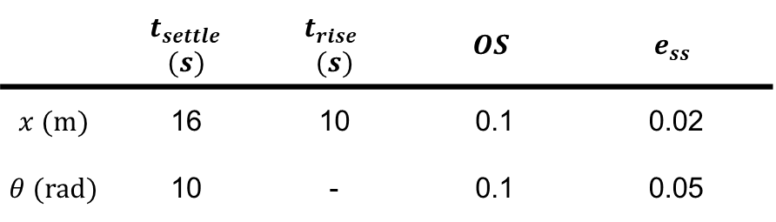
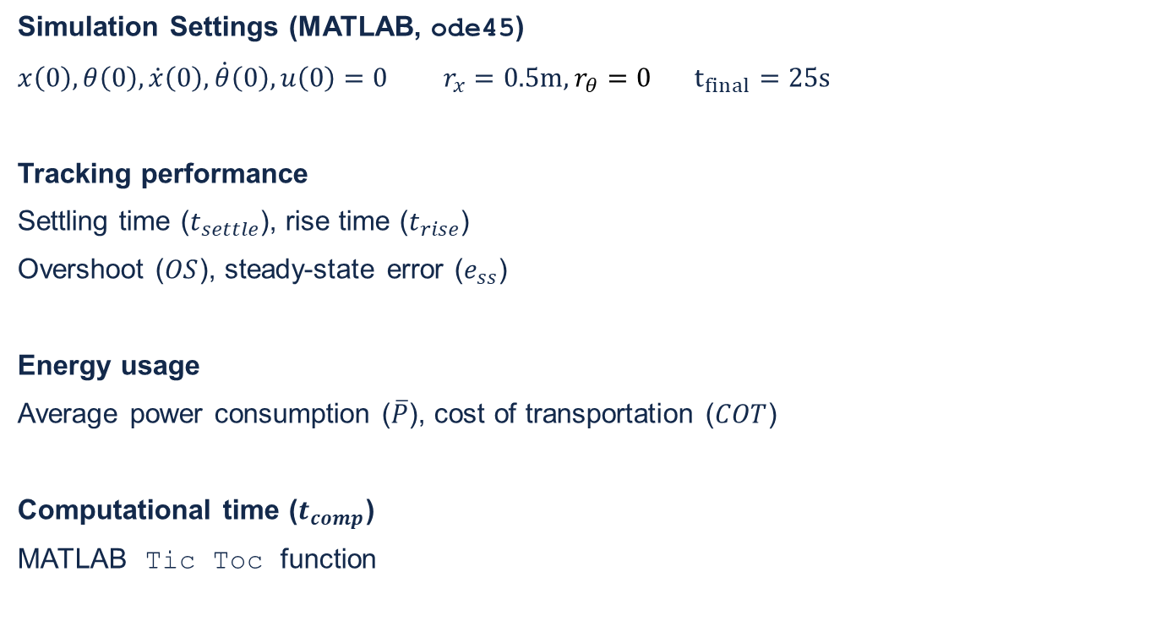
Control Objective and Evaluation
Simulation Settings (MATLAB, ode45)
$x\left(0\right),θ\left(0\right),\dot{x}\left(0\right),\dot{θ}\left(0\right),u\left(0\right)=0 r_{x}=0.5m,r_{θ}=0 t_{final}=25s$
Tracking performance
Settling time ($t_{settle}$), rise time ($t_{rise}$)
Overshoot ($OS$), steady-state error ($e_{ss}$)
Energy usage
Average power consumption ($\overline{P}$), cost of transportation ($COT$)
Computational time ($t_{comp}$)
MATLAB Tic Toc function
Table 1. Control Objectives
 | $t_{settle}$ $(s)$ | $t_{rise}$ $$(s)$$ | $$OS$$ | $$e_{ss}$$
$$x (m)$$ | 16 | 10 | 0.1 | 0.02
$$θ (rad)$$ | 10 | - | 0.1 | 0.05
Notes:
MATLAB and Simulink were used for simulation for three trials : each trial using one of the controllers starting from zero initial condition to reach $desired position of 0.5 m and stable pendulum equilibirum$ within simulation time ($t_{final}$) of 25 seconds.
For each trial, tracking performance, energy usage, and computational time were analyzed.

Slide 5
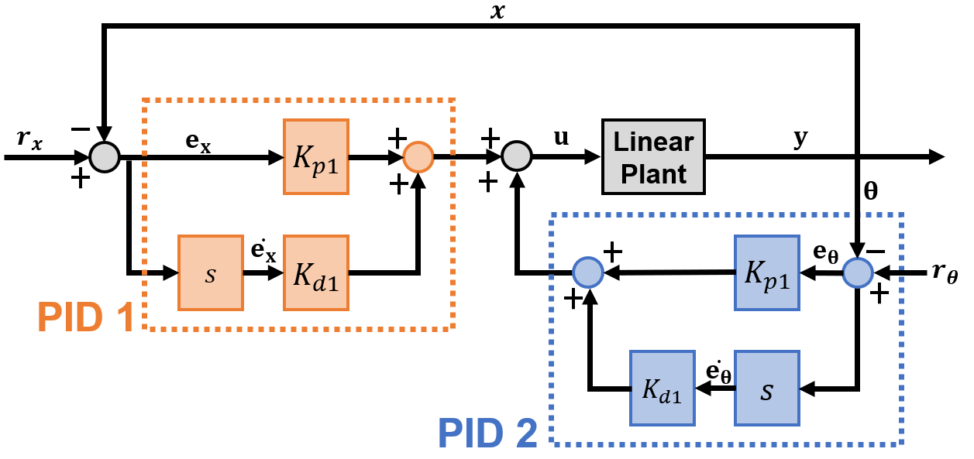
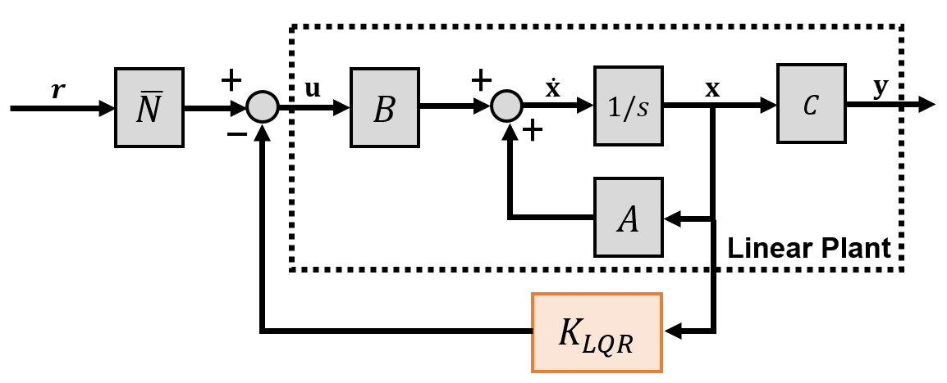
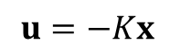
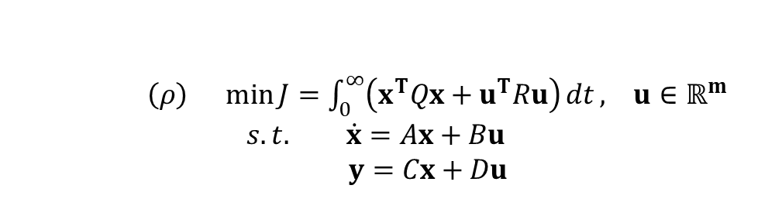
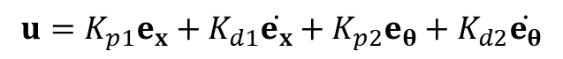
Linear Quadratic Regulator (LQR) & Proportional-Derivative (PD) Ctrl
LQR
PD
Fig. 3. Control diagram for general LQR on LTI system
Fig. 4. Control diagram implementing two PD controllers on an LTI system.
$\left(ρ\right) \min{J=\int_{0}^{∞}{\left(x^{T}Qx+u^{T}Ru\right)}dt}, u∈ℝ^{m}$
$$s.t. \dot{x}=Ax+Bu$$
$y=Cx+Du$
$$u=K_{p1}e_{x}+K_{d1}\dot{e_{x}}+K_{p2}e_{θ}+K_{d2}\dot{e_{θ}}$$
$$u=−Kx$$
Brief explaination
Pros and cons
Animation
Notes:
(LQR) is a full state feedback controller that optimally finds the gain given the weights on tracking performance (Q) and control effort (R) by solving the given cost function and system dynamics.
For PD controller, we used two PD controllers, where the input to the plant was the sum of the two controllers.

Slide 6
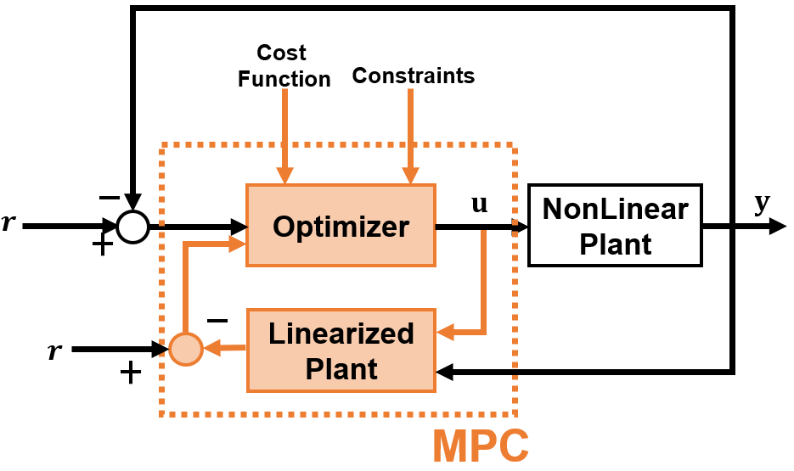
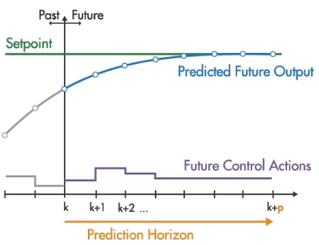
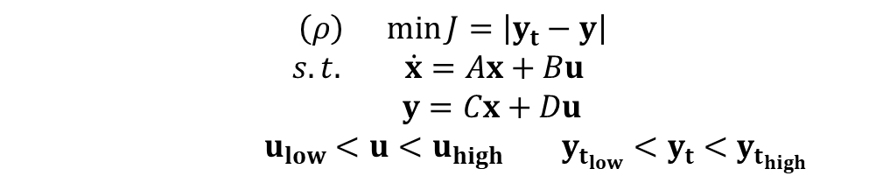
Model Predictive Controller (MPC)
Control Horizon
Fig. 5. Control diagram implementing MPC on a nonlinear system
$\left(ρ\right) \min{J=\left|y_{t}−y\right|}$
$$s.t. \dot{x}=Ax+Bu$$
$y=Cx+Du$
$u_{low}<u<u_{high} y_{t_{low}}<y_{t}<y_{t_{high}}$
Fig. 6. Working concept of MPC.
Notes:
(MPC) is a relatively modern feedback controller for nonlinear systems that optimally finds the actuator input by running multiple predictions of the plant model for various actuator inputs for a short period of time in the future (prediction horizon)
The controller strategically computes the actuator input values for a brief period (control horizon) using an optimizer by minimizing cost function while satisfying the input and output constraints

Slide 7
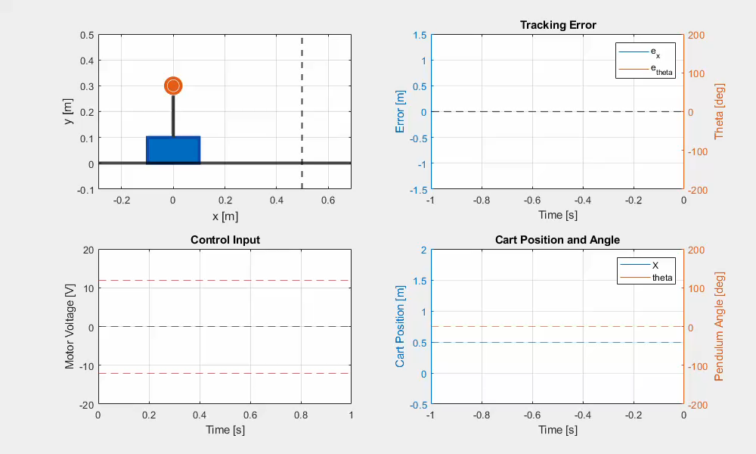

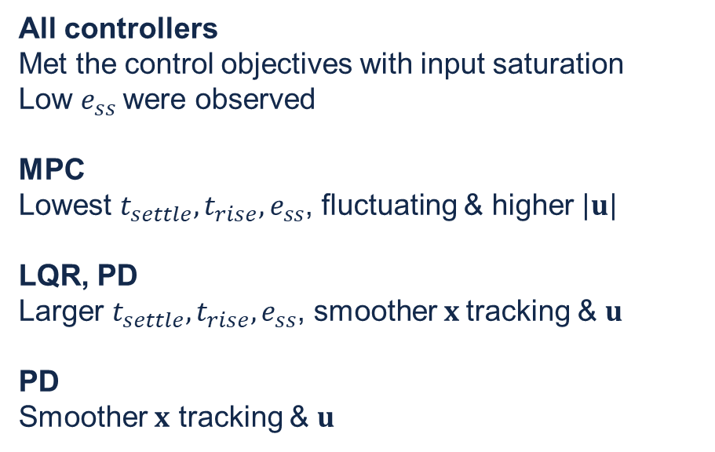
All controllers
Met the control objectives with input saturation
Low $e_{ss}$were observed
MPC
Lowest $t_{settle}, t_{rise},e_{ss}$, fluctuating & higher $\left|u\right|$
LQR, PD
Larger $t_{settle}, t_{rise},e_{ss}$, smoother $x$tracking & $u$
PD
Smoother $x$ tracking & $u$
MPC
LQR
PD
Notes:
All controllers met the control objectives, and only little steady state errors were observed.
The MPC exhibited lowest settling, rise time, and steady state error. The control input was higher in magnitude and fluctating more compared to other controllers.
The LQR,PD exhibited similar tracking performance. Both had larger settling, rise time, steady state error as well as smoother state tracking and control effort than MPC.
In particular, PD controller had smoother tracking and control effort than LQR and MPC.

Slide 8
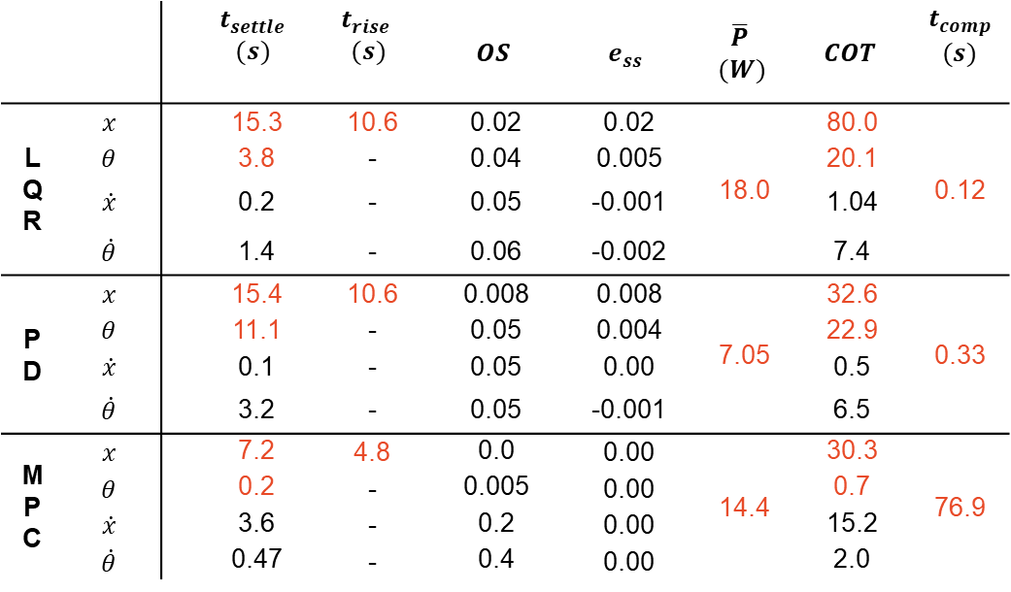
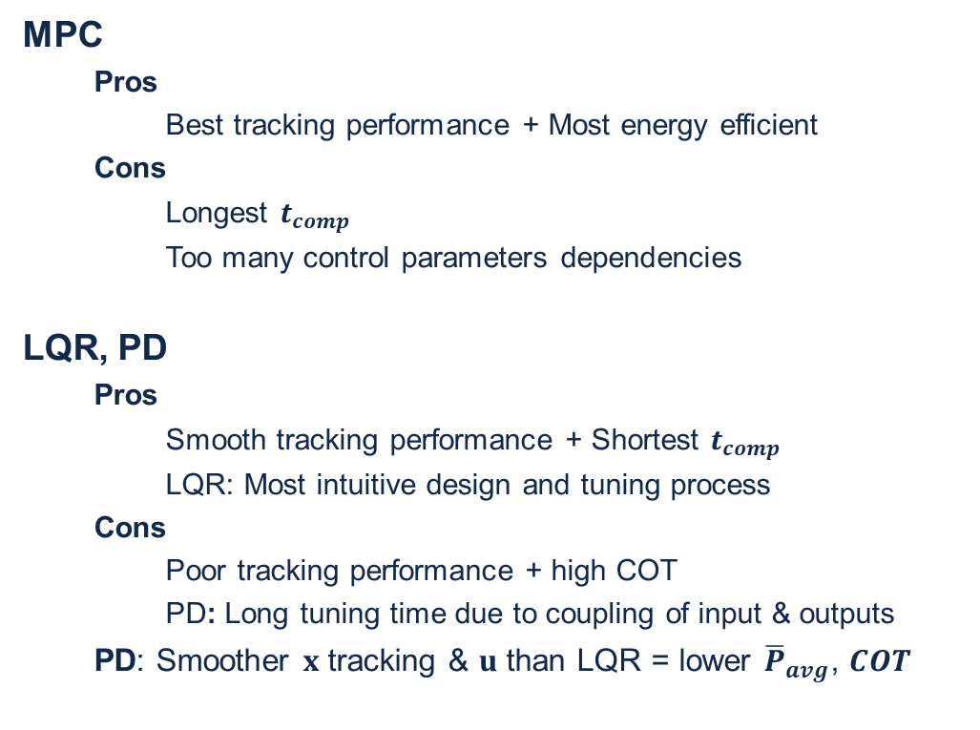
Conclusion
Table 2. Performances of LQR, PD, MPC
MPC
Pros
Best tracking performance + Most energy efficient
Cons
Longest $t_{comp}$
Too many control parameters dependencies
LQR, PD
Pros
Smooth tracking performance + Shortest $t_{comp}$
LQR: Most intuitive design and tuning process
Cons
Poor tracking performance + high COT
PD: Long tuning time due to coupling of input & outputs
PD: Smoother $x$ tracking & $u$ than LQR = lower ${\overline{P}}_{avg}$, $COT$
 |  |  | $$t_{settle}$$ $$(s)$$ | $$t_{rise}$$ $$(s)$$ | $$OS$$ | $$e_{ss}$$ | $$\overline{P}$$ $$(W)$$ | $$COT$$ | $$t_{comp}$$ $$(s)$$
LQR | $$x$$ |  | 15.3 | 10.6 | 0.02 | 0.02 | 18.0 | 80.0 | 0.12
 | $$θ$$ |  | 3.8 | - | 0.04 | 0.005 |  | 20.1
 | $$\dot{x}$$ |  | 0.2 | - | 0.05 | -0.001 |  | 1.04
 | $$\dot{θ}$$ |  | 1.4 | - | 0.06 | -0.002 |  | 7.4
PD | $$x$$ |  | 15.4 | 10.6 | 0.008 | 0.008 | 7.05 | 32.6 | 0.33
 | $$θ$$ |  | 11.1 | - | 0.05 | 0.004 |  | 22.9
 | $$\dot{x}$$ |  | 0.1 | - | 0.05 | 0.00 |  | 0.5
 | $$\dot{θ}$$ |  | 3.2 | - | 0.05 | -0.001 |  | 6.5
MPC | $$x$$ |  | 7.2 | 4.8 | 0.0 | 0.00 | 14.4 | 30.3 | 76.9
 | $$θ$$ |  | 0.2 | - | 0.005 | 0.00 |  | 0.7
 | $$\dot{x}$$ |  | 3.6 | - | 0.2 | 0.00 |  | 15.2
 | $$\dot{θ}$$ |  | 0.47 | - | 0.4 | 0.00 |  | 2.0
The choice of “best” controller depends on the design requirement.
LQR/PD is more practical for controlling physical systems online with limited computing resources.
MPC is more practical for controlling virtual system offline and if tracking performance was critical.
Notes:
Each controller had distinctive pros and cons.
MPC had best tracking performance and highest energy efficiency with the expense of longest computation time. This was expected since MPC required computation of numerous predictions of the plant model and optimizations of the actuation input for every loop. Also, MPC had too many control parameters that depended on one another, resulting in difficult tuning process.
LQR and PD both had smooth tracking performances with shortest computational time. The short computational time was expected since the equations were all linear and didn’t require predictions of the plant model. The LQR had the most intuitive design and tuning process, since it required only two most relevant control parameters such Q and R matrix without worrying about the coupling effect between the input and output.
However, PD took a long tuning time due to coupling effect of input & outputs. Also both LQR and PD had slow tracking performance and higher cost of transportation compared to MPC. It is interesting to note that the PD had smoother state tracking and control effort than LQR, resulting in lower power consumption and thus cost of transportation.
To conclude, The ideal controller depends on the engineer’s requirement.
LQR/PD is more practical for controlling physical systems online with limited computing resources with the expense of tracking performance, while MPC is more practical for controlling virtual system offline and if tracking performance was critical.

Slide 9
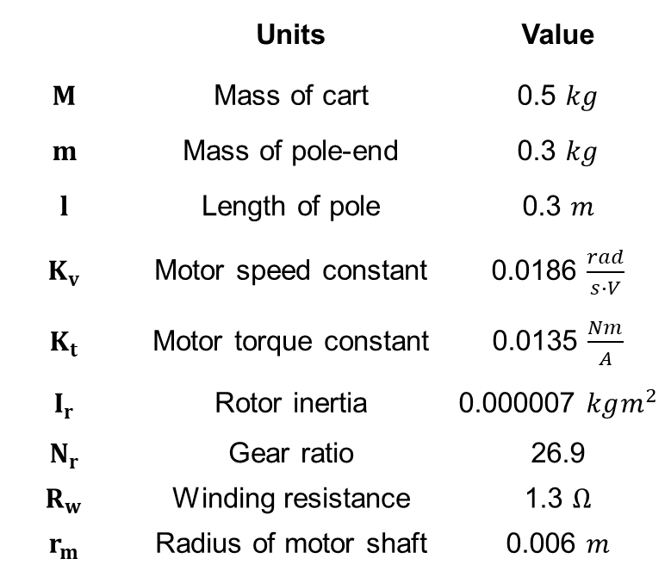
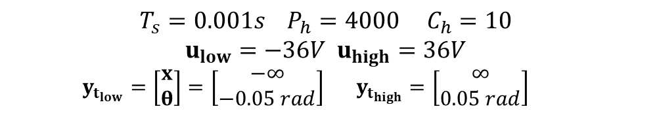
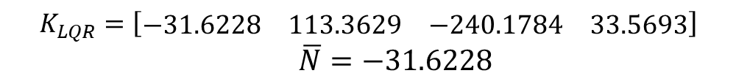
Appendix
MPC Parameters
 | Units | Value
$$M$$ | Mass of cart | 0.5 $kg$
$$m$$ | Mass of pole-end | 0.3 $kg$
$$l$$ | Length of pole | 0.3 $m$
$$K_{v}$$ | Motor speed constant | 0.0186 $\frac{rad}{s∙V}$
$$K_{t}$$ | Motor torque constant | 0.0135 $\frac{Nm}{A}$
$$I_{r}$$ | Rotor inertia | 0.000007 $kgm^{2}$
$$N_{r}$$ | Gear ratio | 26.9
$$R_{w}$$ | Winding resistance | 1.3 $Ω$
$$r_{m}$$ | Radius of motor shaft | 0.006 $m$
$K_{LQR}=\left[\begin{matrix}−31.6228 & 113.3629 & −240.1784 & 33.5693\end{matrix}\right]$ $\overline{N}=−31.6228$
PD Parameters
$$K_{p1},K_{d1}=−50,−400 K_{p2},K_{d2}=150, 100$$
MPC Parameters
$T_{s}=0.001s P_{h}=4000 C_{h}=10$
$u_{low}=−36V u_{high}=36V$
$y_{t_{low}}=\left[\begin{aligned}x \\ θ\end{aligned}\right]=\left[\begin{aligned}−∞ \\ −0.05 rad\end{aligned}\right] y_{t_{high}}=\left[\begin{aligned}∞ \\ 0.05 rad\end{aligned}\right]$
Notes:
Then next few slides explain the system, controller, and evaluation parameters in detail.

Slide 10
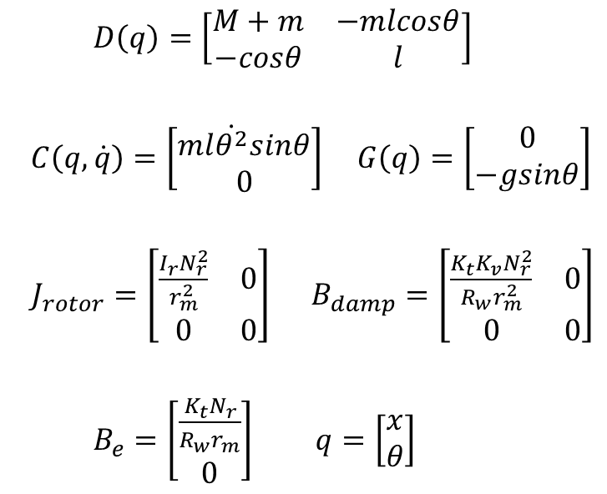
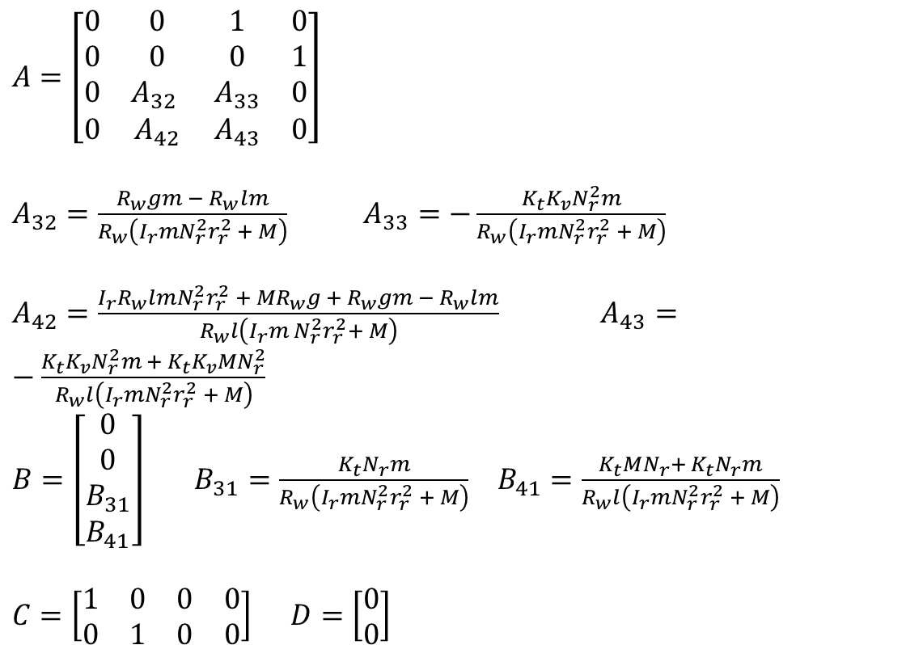
Appendix
Linear System Details
$A=\left[\begin{matrix}0 & 0 & 1 & 0 \\ 0 & 0 & 0 & 1 \\ 0 & A_{32} & A_{33} & 0 \\ 0 & A_{42} & A_{43} & 0\end{matrix}\right]$
$A_{32}=\frac{R_{w}gm − R_{w}lm}{R_{w}\left(I_{r}mN_{r}^{2}r_{r}^{2} + M\right)}$ $A_{33}=−\frac{K_{t}K_{v}N_{r}^{2}m}{R_{w}\left(I_{r}mN_{r}^{2}r_{r}^{2} + M\right)}$
$A_{42}=\frac{I_{r}R_{w}lmN_{r}^{2}r_{r}^{2} + MR_{w}g + R_{w}gm − R_{w}lm}{R_{w}l\left(I_{r}m N_{r}^{2}r_{r}^{2}+ M\right)}$ $A_{43}=−\frac{K_{t}K_{v}N_{r}^{2}m + K_{t}K_{v}MN_{r}^{2}}{R_{w}l\left(I_{r}mN_{r}^{2}r_{r}^{2} + M\right)}$
$B=\left[\begin{matrix}0 \\ 0 \\ B_{31} \\ B_{41}\end{matrix}\right]$ $B_{31}=\frac{K_{t}N_{r}m}{R_{w}\left(I_{r}mN_{r}^{2}r_{r}^{2} + M\right)}$ $B_{41}=\frac{K_{t}MN_{r}+ K_{t}N_{r}m}{R_{w}l\left(I_{r}mN_{r}^{2}r_{r}^{2} + M\right)}$
$C=\left[\begin{matrix}1 & 0 & 0 & 0 \\ 0 & 1 & 0 & 0\end{matrix}\right] D=\left[\begin{aligned}0 \\ 0\end{aligned}\right]$
Nonlinear System Details
$D\left(q\right)=\left[\begin{matrix}M+m & −mlcosθ \\ −cosθ & l\end{matrix}\right]$
$C\left(q,\dot{q}\right)=\left[\begin{matrix}ml\dot{θ^{2}}sinθ \\ 0\end{matrix}\right] G\left(q\right)=\left[\begin{aligned}0 \\ −gsinθ\end{aligned}\right]$
$J_{rotor}=\left[\begin{matrix}\frac{I_{r}N_{r}^{2}}{r_{m}^{2}} & 0 \\ 0 & 0\end{matrix}\right] B_{damp}=\left[\begin{matrix}\frac{K_{t}K_{v}N_{r}^{2}}{R_{w}r_{m}^{2}} & 0 \\ 0 & 0\end{matrix}\right]$
$B_{e}=\left[\begin{aligned}\frac{K_{t}N_{r}}{R_{w}r_{m}} \\ 0\end{aligned}\right] q=\left[\begin{aligned}x \\ θ\end{aligned}\right]$

Slide 11
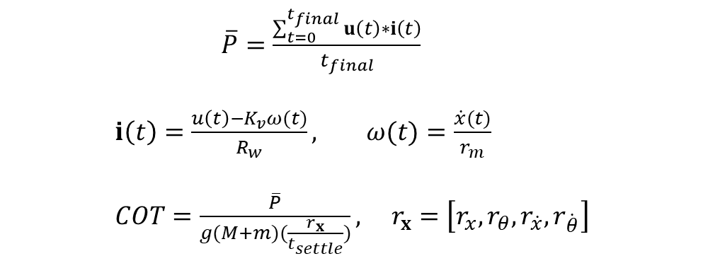
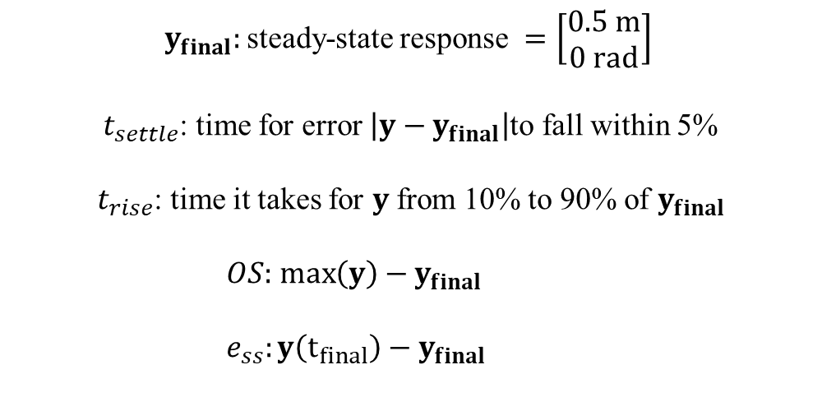
Appendix
Evaluation Metrics Definition
$y_{final}:$steady-state response $=\left[\begin{aligned}0.5 m \\ 0 rad\end{aligned}\right]$
$t_{settle}$: time for error $\left|y−y_{final}\right|$to fall within 5%
$t_{rise}$: time it takes for $y$ from 10% to 90% of $y_{final}$
$OS:$ $\max\left(y\right)−y_{final}$
$e_{ss}:y\left(t_{final}\right)−y_{final}$
$\overline{P}=\frac{\sum_{t=0}^{t_{final}}{u\left(t\right)∗i\left(t\right)}}{t_{final}}$
$i\left(t\right)=\frac{u\left(t\right)−K_{v}ω(t)}{R_{w}}, ω(t)=\frac{\dot{x}(t)}{r_{m}}$
$COT=\frac{\overline{P}}{g(M+m)(\frac{r_{x}}{t_{settle}})}, r_{x}=\left[r_{x},r_{θ},r_{\dot{x}},r_{\dot{θ}}\right]$

